Slide 1
Sales Forecasting for Furniture Store
varun kumar

Slide 2
Introduction
In this task, we figure out the market demand with respect to promos and sales.
During that process, we follow up those steps, below:
Welcome to the Machine Learning project, focused on forecasting the sales of a furniture store. In this
project, you will delve into the world of time series analysis, exploring various techniques to predict sales and optimize inventory for sustained business operations.

Slide 3
Summary
For a retail furniture store, predicting future sales is critical to avoiding inventory issues like overstocking
or under-stocking. The challenge lies in utilizing time series data from the superstore dataset to forecast
furniture sales for the next year accurately. This predictive insight ensures an optimal customer
experience, avoids losses, and maintains store sustainability.
Your Mission:
Your mission in this project is to forecast furniture sales by leveraging time series data. Follow these key
steps:
1. Understanding Time Series Data:
Dive into the superstore dataset and grasp the fundamentals of time series data.
2. Checking Components of Time Series:
Identify and analyze the various components of time series data, such as trends and seasonality.
3. Forecasting Techniques:
Utilize a range of time series forecasting techniques to predict furniture sales for the next year.
4. Visualization in Time Series:
Develop an understanding of effective visualization techniques for time series data.

Slide 4
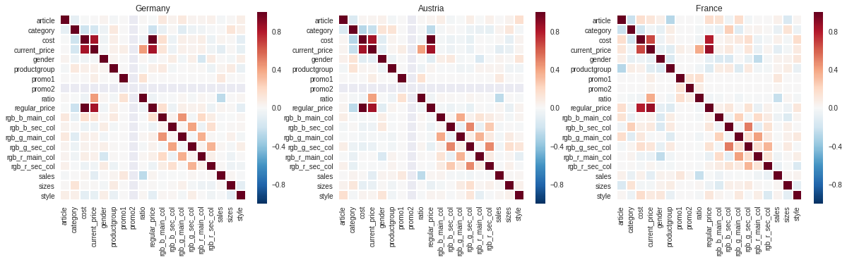
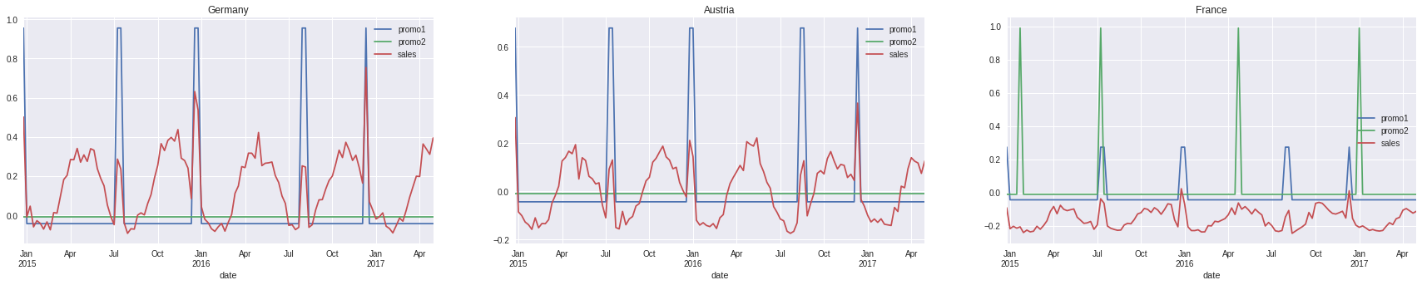
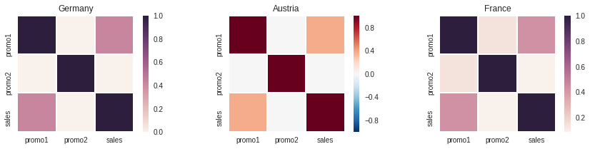
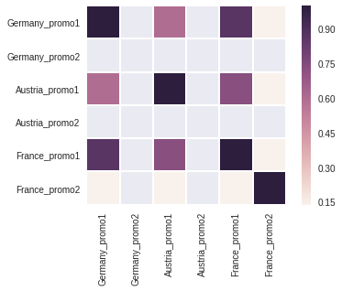
A quick glance to data
Feature Correlation Matrices by Country
All countries have similar correlation matrix with respect to the features of product.
According to those matrices, promo1 and promo2
don’t have neither positive neither negative
correlation with any kind of features.
There are significant high correlated features.
However, we skipped them in this step.
According to the normalized graphs related to
Promo1, Promo2 and Sales, we can see the effects of Promo1 and Promo2 on top of Sales
The promos based on Germany and Austria may have same patterns on the sales. However, France has more different pattern than the rest two countries.
Promo2 may have more positive effects than Promo1 on the sales in France.
Promo2 may less contribution on the sales some points on the graph as we pointed out with “?”. That proposal is also improved by the correlation matrices (bottom left).
Promo2 is not available for German and Austria.
Promo1 may have similar pattern on the sales in the both Germany and Austria
After this first introduction, we need to verify these patterns on the sales.
In all countries, Promo1 has positive correlations according to the correlation matrices (bottom left).
Promo1, Promo2 vs Sales by Month (Normalized)
?
?
?
?
?
Correlation of Promo1, Promo2, Sales by Country
?

Slide 5
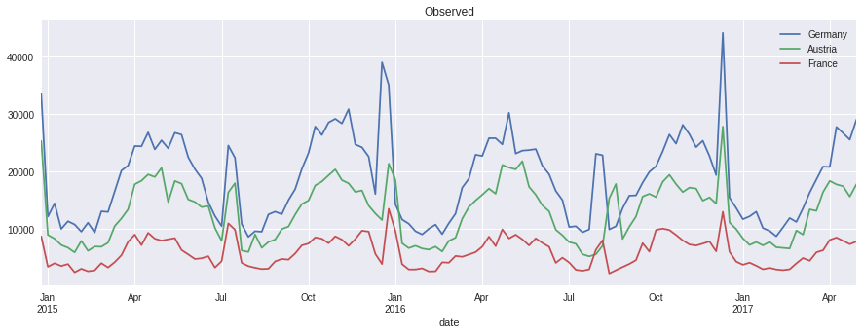
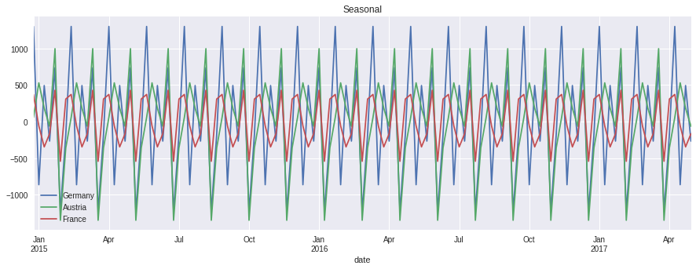
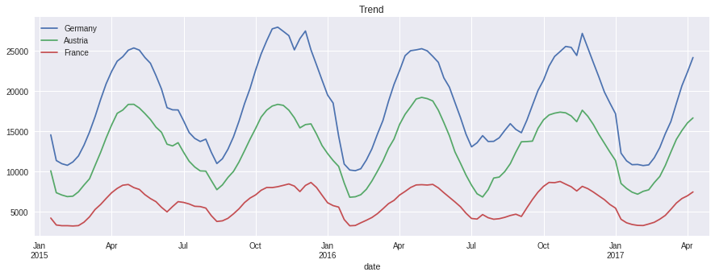
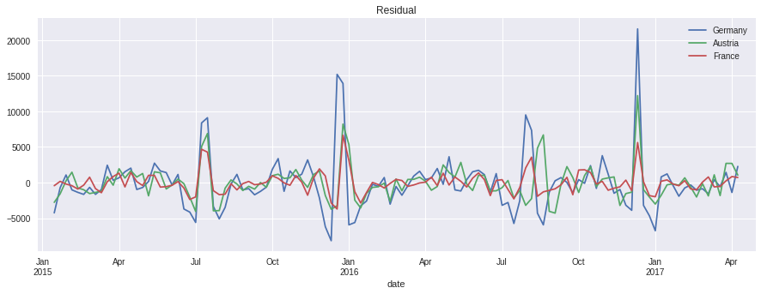
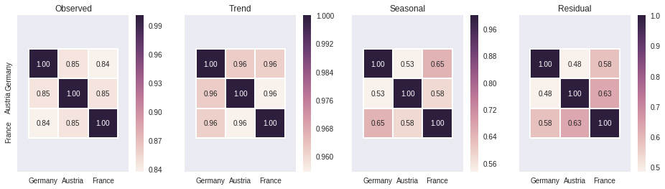
Time Series Analysis – Decomposition - Approach#1
After applying time series decomposition, we got three different components, such as Trend, Seasonal, Residual as shown above.
?
After decomposition, our expectation is that residual component has to be stationary. It seems stationary, overall. However, a few critical effects rather than noise affects the curve where we point out. Mostlikely, those effects may be related to promos since promos don’t have neither seasonal nor threading patterns.

Slide 6
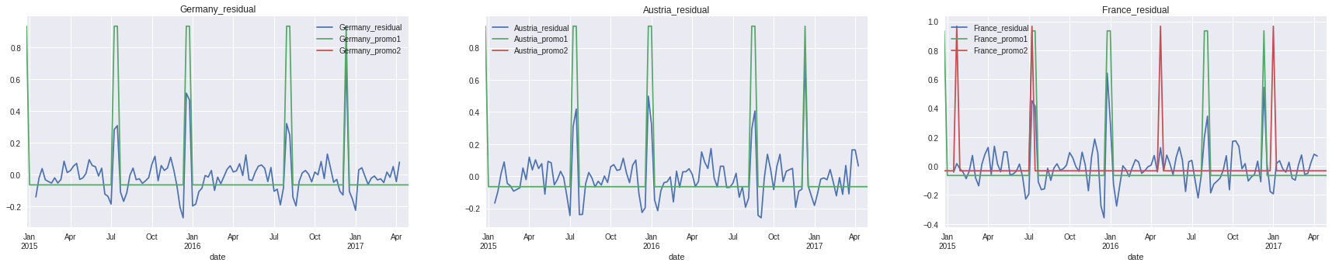
Comparing Promos and Residual
Promo1, Promo2 vs Residual by Country (Normalized)
No effect
According to the graphs, above, our residual components have promos’ effects as we discussed in the previous slide.
Germany and Austria have same effect in terms of promos on the residual.
However, France has more different pattern than the rest country. As we proposed at the beginning, Promos may not work for France market well. In this graph, we can obviously see.
Promo2 don’t have positive effect on the sales mostly.

Slide 7
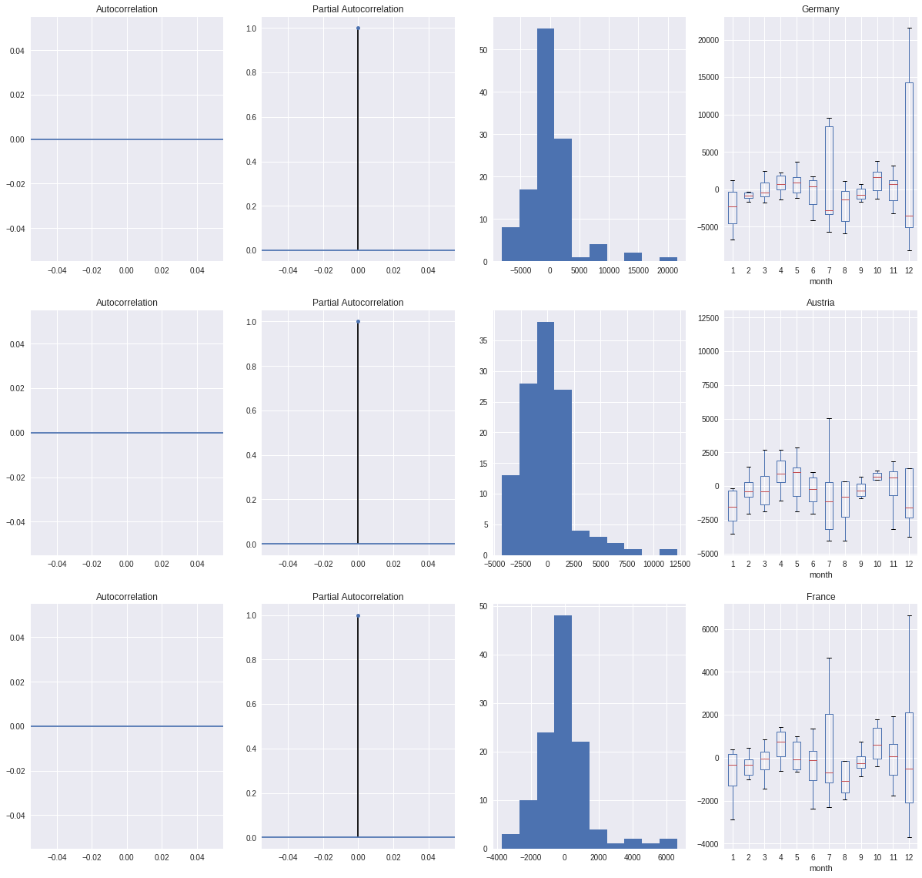
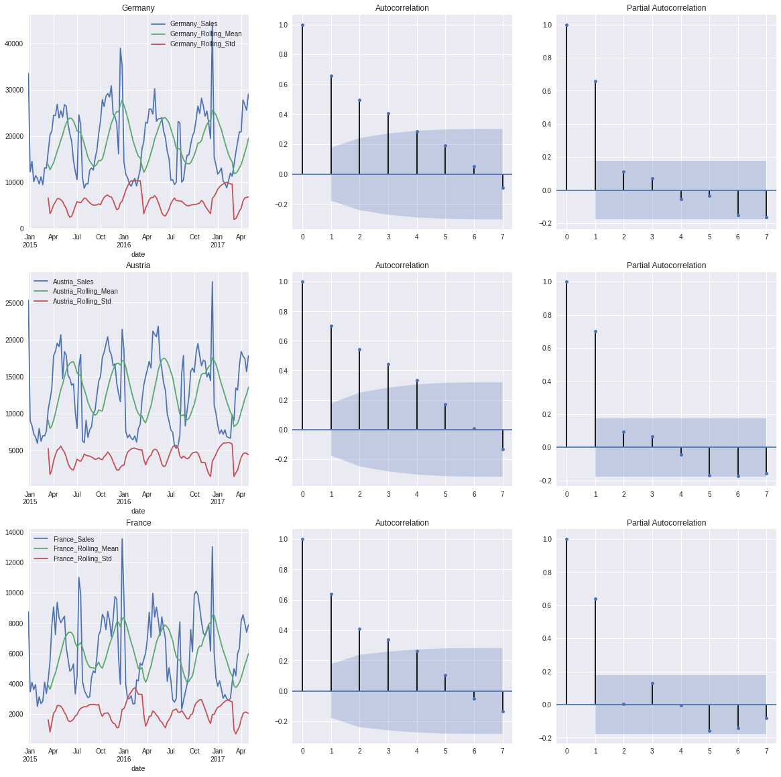
Modeling Time Series
Autocorrelation, Partial Autocorrelation, Histogram, Boxplot
on Residual Component
Moving Average, Moving STD
To check the stationarity of residual component, we used those methods, above.
According to boxplot, the variance is a little bit high due to promos effects.
According to autocorrelation, there is no strongly correlate lags on this component.
In addition these approaches, we can take difference (d = x(t) – t(t -1)) of actual series to obtain stationary components well.
Before building a model for forecasting by using SARIMAX, we processed the data by using moving mean and std
According to autocorrelation function, we have four powerful lags to use as a MA(4) order.

Slide 8
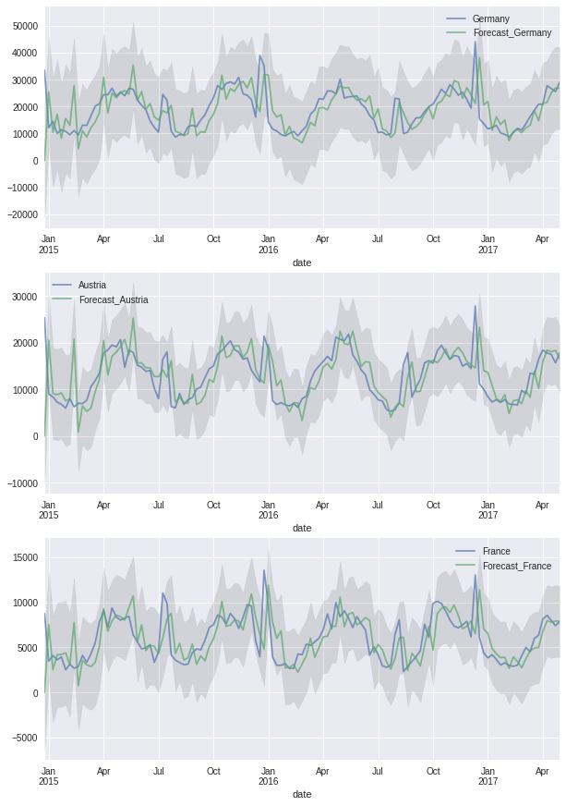
Forecasting
We built three different models for each country to forecast the sales
As you see in the graphs, there are two curves such as actual sales and forecasting sales.
At this point any given date, we can make a forecasting about our future sales, roughly.

Slide 9
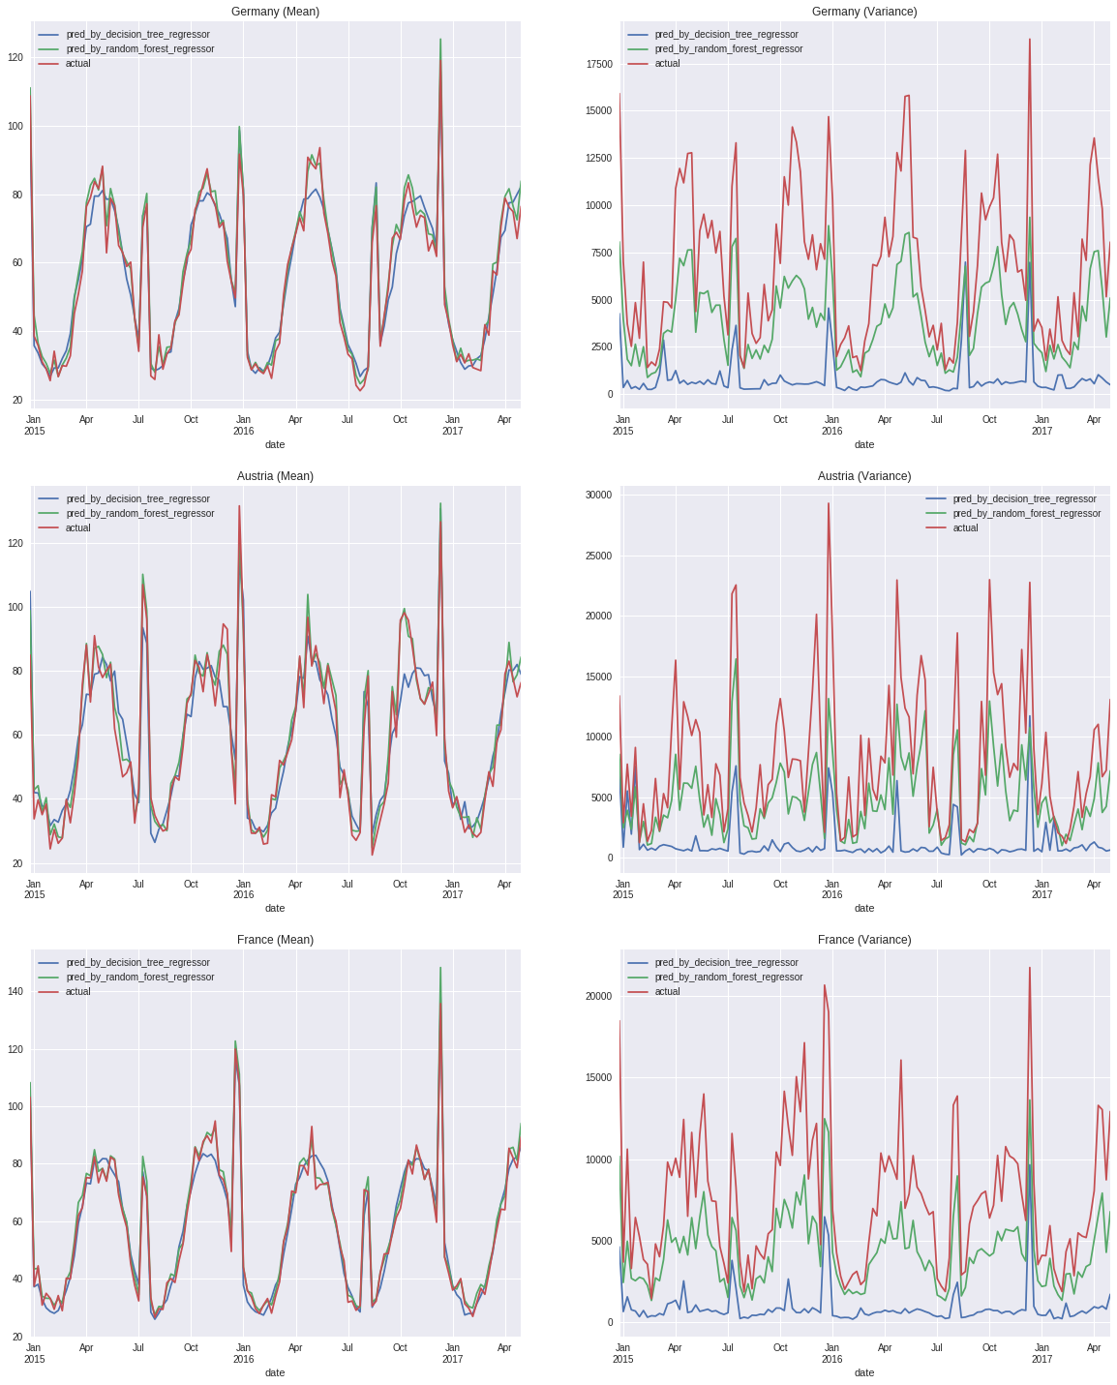
Regression - Approach#2
Actual vs Expected Sales (Mean)
Actual vs Expected Sales (Variance)
To see all features impact to sales,
We used ML algorithm.
Regression Tree is kind of regression
method that takes categorical inputs and
maps to continues value.
In our case, sales is target feature. The rest of them is input features.
We also used Random Forest Regression. However, its performance worse than regression tree since it is over-fitting according to its variance graph.

